Slide 1
ENGI 301 Ready, Set, Candy! Proposal
09/25/2023
Sunny Yu

Slide 2
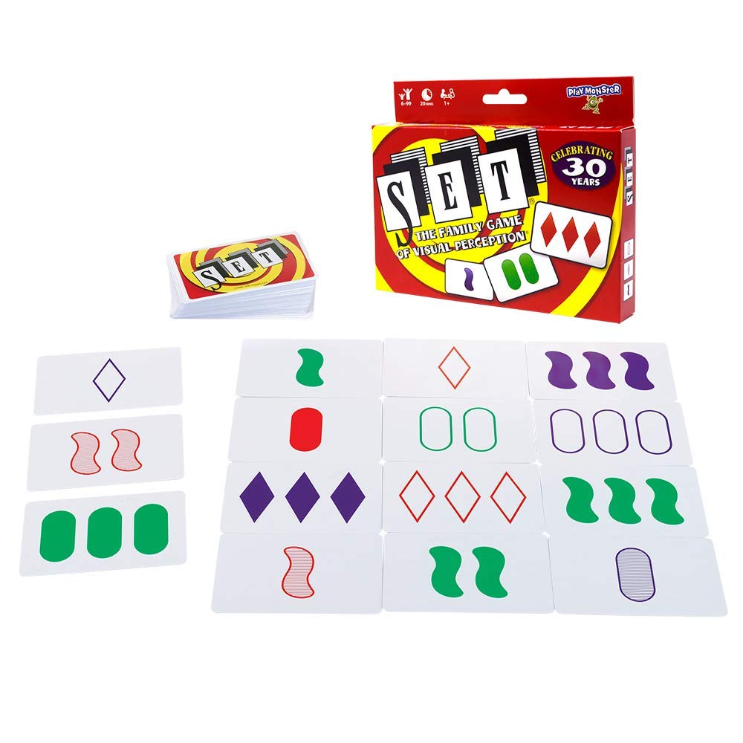

Background Information
Project motivation
When I get stressed, I tend to lack self-control in how long I spend playing games and how much candy I consume. Although these two actions seem unrelated, I realized that I could address both of these problems through Ready, Set, Candy!
Ready, Set, Candy! Proposal
Users can play one round of Set, a logic card game, per day in exchange for a predetermined portion of candy
12 cards are displayed -> user finds all 6 sets -> candy gets dispensed
https://www.setgame.com/set/puzzle <- puzzle of the day
Existing projects/libraries:
Candy Game Box: https://www.hackster.io/candy-game-box
Tap Test: https://www.hackster.io/tap-test
Improvements/additions over existing project
This project will allow users to play Set and dispense premeasured amounts of candy. The software will be customized to allow the user to choose how frequently they want to play, time limits, etc. There will also be a sensor for when to refill the candy.
Rules of Set:
Each card has 4 features: color, number, shape, and shading
The 3 cards in a set must display each feature as either
A) all the same
B) all different

Slide 3
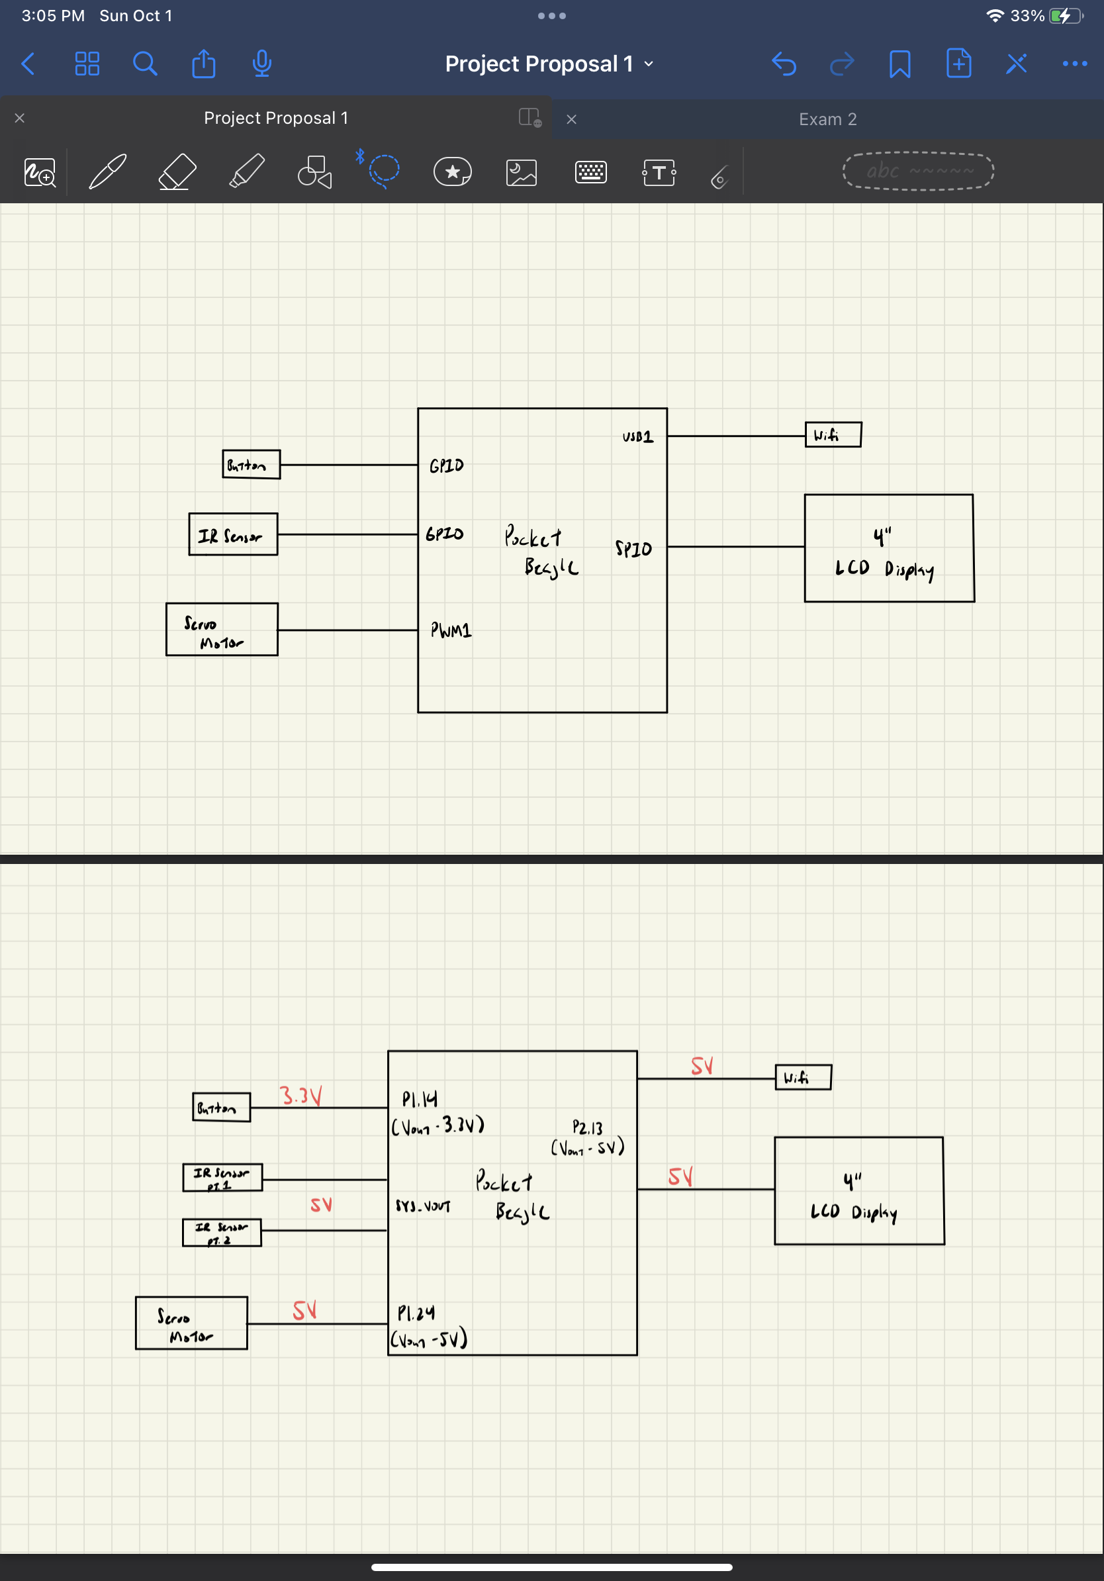
System Block Diagram

Slide 4
Power Block Diagram

Slide 5
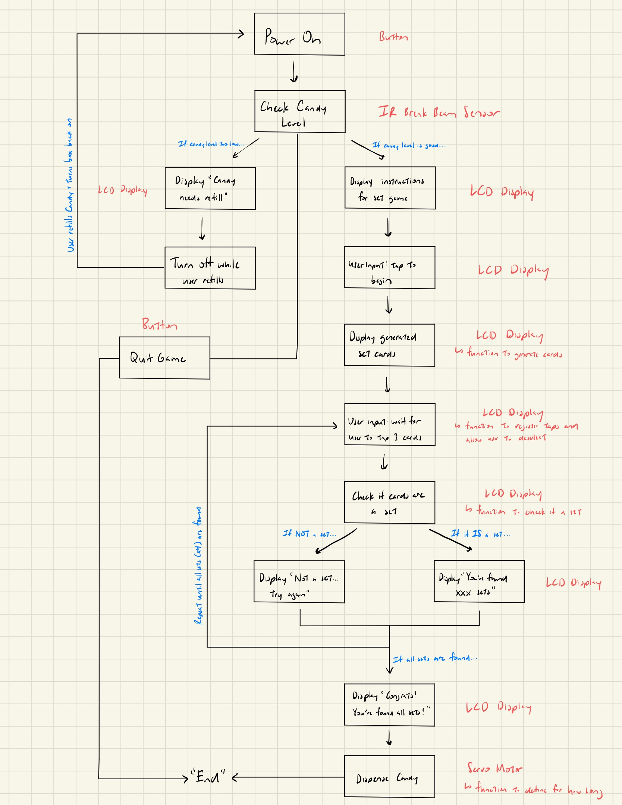
Software Block Diagram (zoomed out)

Slide 6
Software Block Diagram (zoomed in)

Slide 7
Components / Budget
Component | Need to Buy | Cost
BeagleBoard.org PocketBeagle | No | -
4 inch LCD Display | 1 | $21.69
Amazon - USB Wifi | 1 | $9.99
Amazon - Servo Motor | 1 | $25.99
Adafruit - IR Break Beam Sensor | 1 | $6.49
Button (x1) | No | -
Breadboard (x1) | No | -
Resistors | No | -
Wood | No | -

